Slide 1
Shodan
Industrial Control Reconnaissance

Slide 2
What is Shodan
Shodan (http://www.shodan.io/) –a web based search engine designed by John Matherly
Different from content search engines (such as Google or Bing)
Shodan interrogates ports and grabs the resulting banners, then indexes the banners for searching

Slide 3
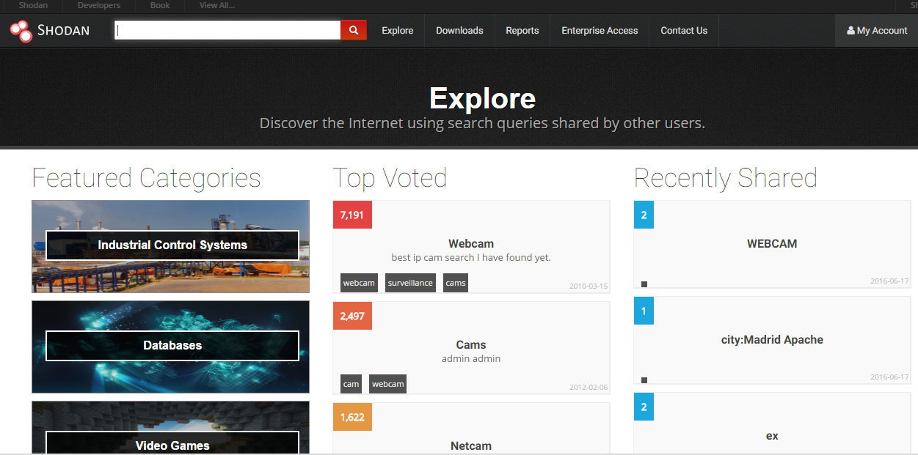
What is Shodan

Slide 4
Shodan Search
Basic Operations: Search
Search terms are entered into a text box
Quotation marks can narrow a search
Boolean operators + and – can be used to include and exclude query terms (+ is implicit default)

Slide 5
Shodan Search Filters
country: two letter country code
hostname: specify hostname or domain
net: specify IP range or subnet
os: search for specific operating systems
port: specify service port

Slide 6
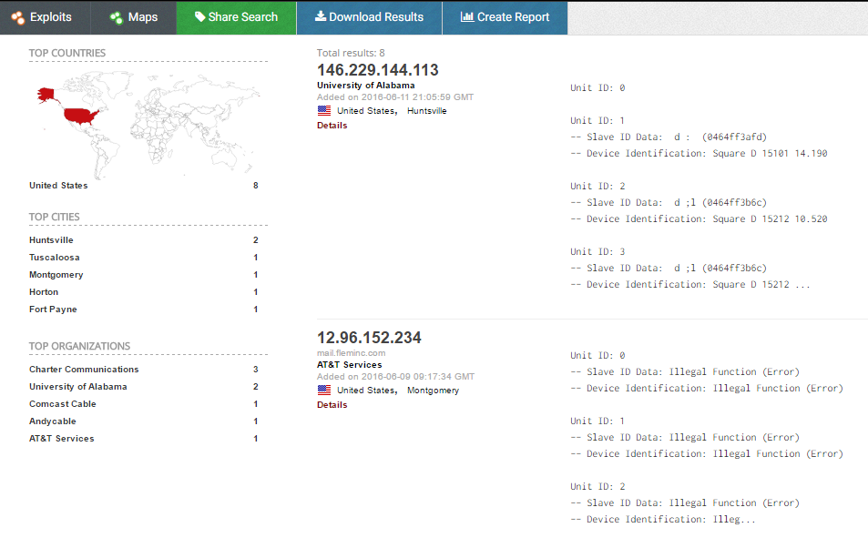
Shodan Search

Slide 7
Alternative: Nmap Modbus-discover
Enumerates SCADA Modbus slave ids (sids) and collects their device information.
This script does Modbus device information disclosure. It tries to find legal sids (slave ids) of Modbus devices and to get additional information about the vendor and firmware.
Download the script modbus-discover.nse from
https://nmap.org/nsedoc/scripts/modbus-discover.html

Slide 8
Alternative: Nmap Modbus-discover
Example:
nmap --script modbus-discover.nse --script-args='modbus-discover.aggressive=true' -p 502 <host>
Output:
PORT STATE SERVICE
502/tcp open modbus
| modbus-discover: | sid 0x64:
| Slave ID data: \xFA\xFFPM710PowerMeter
| Device identification: Schneider Electric PM710 v03.110
| sid 0x96:
|_ error: GATEWAY TARGET DEVICE FAILED TO RESPONSE

